Slide 1
String Methods

Slide 2
Mr. M.R. Solanki
Sr. Lecturer, Information Technology,
manish_ratilal2002@yahoo.com
SBMP

Slide 3
Learning Outcomes
Students will be able to:
Describe the working of String methods with example code snippet
Use String methods in Java programs.

Slide 4
String Constructors

Slide 5
String class
The String class supports several constructors. To create an empty String, call the default constructor.
String s = new String();
To initialize the String object:
String s = new String(“Hello”);
OR
String s = “Hello”; // short hand notation

Slide 6
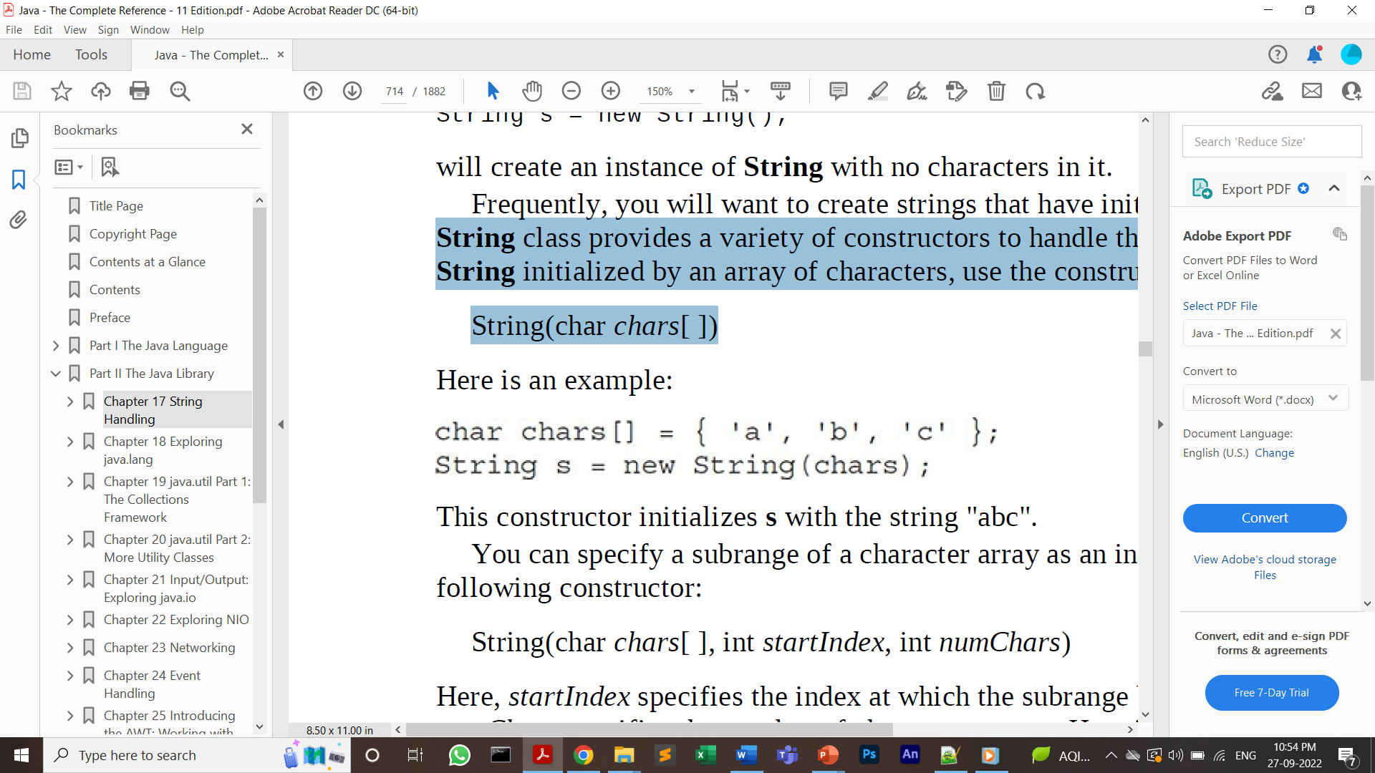
Character array to string
To create a String initialized by an array of characters, use the constructor shown here:
String(char chars[ ])
Note: It converts an array of characters to a String

Slide 7
String Methods

Slide 8
length()
The length of a string is the number of characters that it contains.
String str= "Hello Friends!!!";
System.out.println(str.length());
Finding length of a String literal.
System.out.println("abc".length());

Slide 9
Concatenation
‘+’ operator is used to concatenate multiple strings and mixed data types
Finding length of a String literal.
System.out.println("abc".length());

Slide 10
Concatenation
concat( )
Concatenates two strings:
String concat(String str)
This method creates a new object that contains the invoking string with the contents of str appended to the end.
concat( ) performs the same function as +

Slide 11
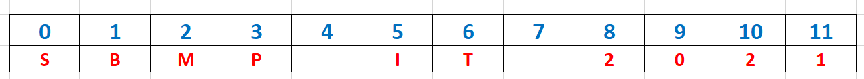
Character Extraction
charAt( ) - To extract a single character from a String
Format: char charAt(int where) // where = index of character
Sring str= "SBMP IT 2021";
System.out.println(str.charAt(5));
I

Slide 12
Character Extraction
charAt( ) can be used to read a single character using Scanner class.
Example:
char grade;
System.out.println("Enter the grade of an Employee");
grade= sc.next().charAt(0); // will extract 0th char from the input string

Slide 13
string to array of characters
toCharArray( )
If you want to a String object into a character array, the easiest way is to call toCharArray( ).
It returns an array of characters for the entire string. It has this general form:
char[ ] toCharArray( )
String str= "Hello";
char ch[] = str.toCharArray();
for (int i=0;i<ch.length;i++)
{
System.out.println(ch[i]);
}

Slide 14
String Comparison
To compare two strings for equality, use equals( ).
boolean equals(Object str)
Here, str is the String object being compared with the invoking String object.
It returns true if the strings contain the same characters in the same order, and
false otherwise.
The comparison is case-sensitive.
String str1= "Hello";
String str2= "Hello";
String str3= "Helo";
System.out.println("str1 and str2 comparison result:"+str1.equals(str2));
System.out.println("str1 and str3 comparison result:"+str1.equals(str3));

Slide 15
String Comparison
To perform a comparison that ignores case differences, call equalsIgnoreCase( ).
When it compares two strings, it considers A-Z to be the same as a-z.

Slide 16
equals( ) Versus ==
The equals( ) method compares the characters inside a String object. The == operator compares two object references to see whether they refer to the same instance.
String str1= "Hello";
String str2= new String(str1);
System.out.println("str1 and str2 comparison with == :"+(str1==str2));
str1 and str2 comparison with == :false

Slide 17
String Comparison
For sorting applications, you need to know which is less than, equal to, or greater than the next.
A string is less than another if it comes before the other in dictionary order. (alphabetically upper)
A string is greater than another if it comes after the other in dictionary order. (alphabetically lower)

Slide 18
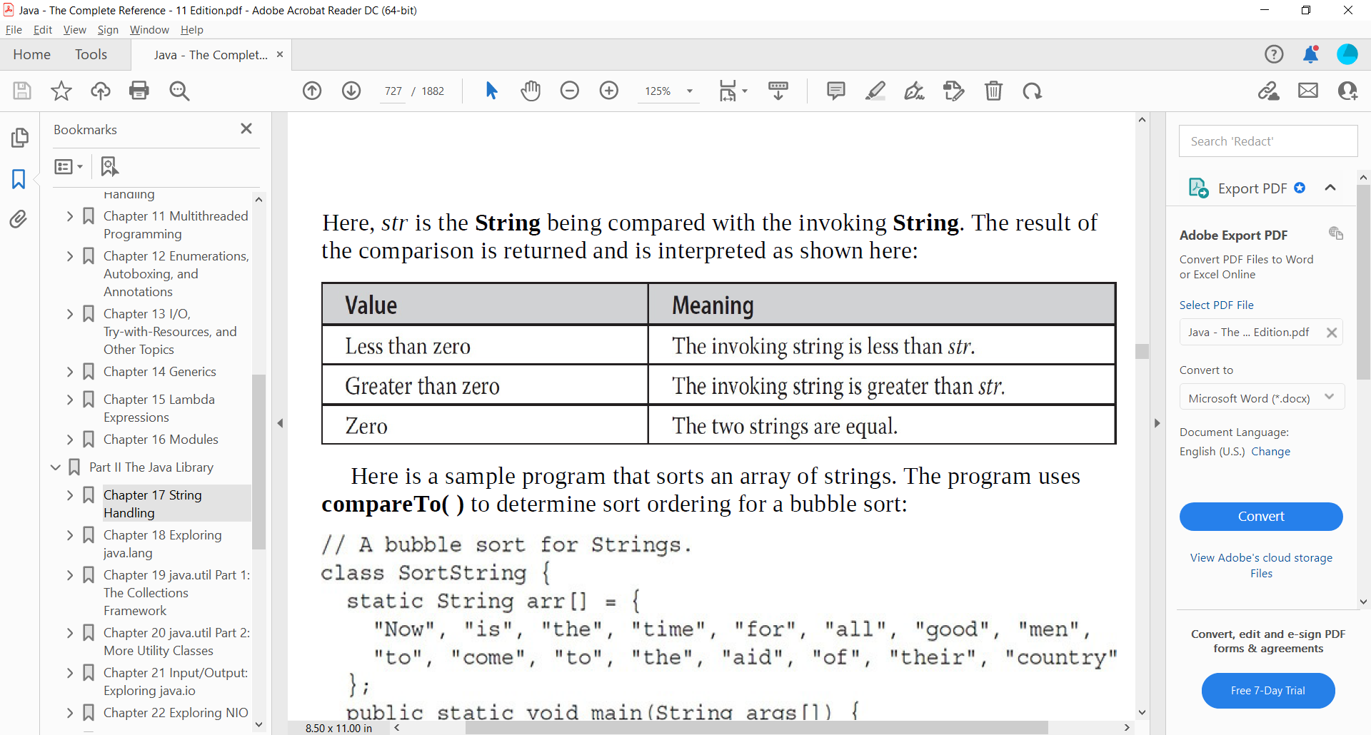
String Comparison
int compareTo(String str)
String str1= "there";
String str2= "their";
System.out.println(str1.compareTo(str2));
System.out.println(str2.compareTo(str1));

Slide 19
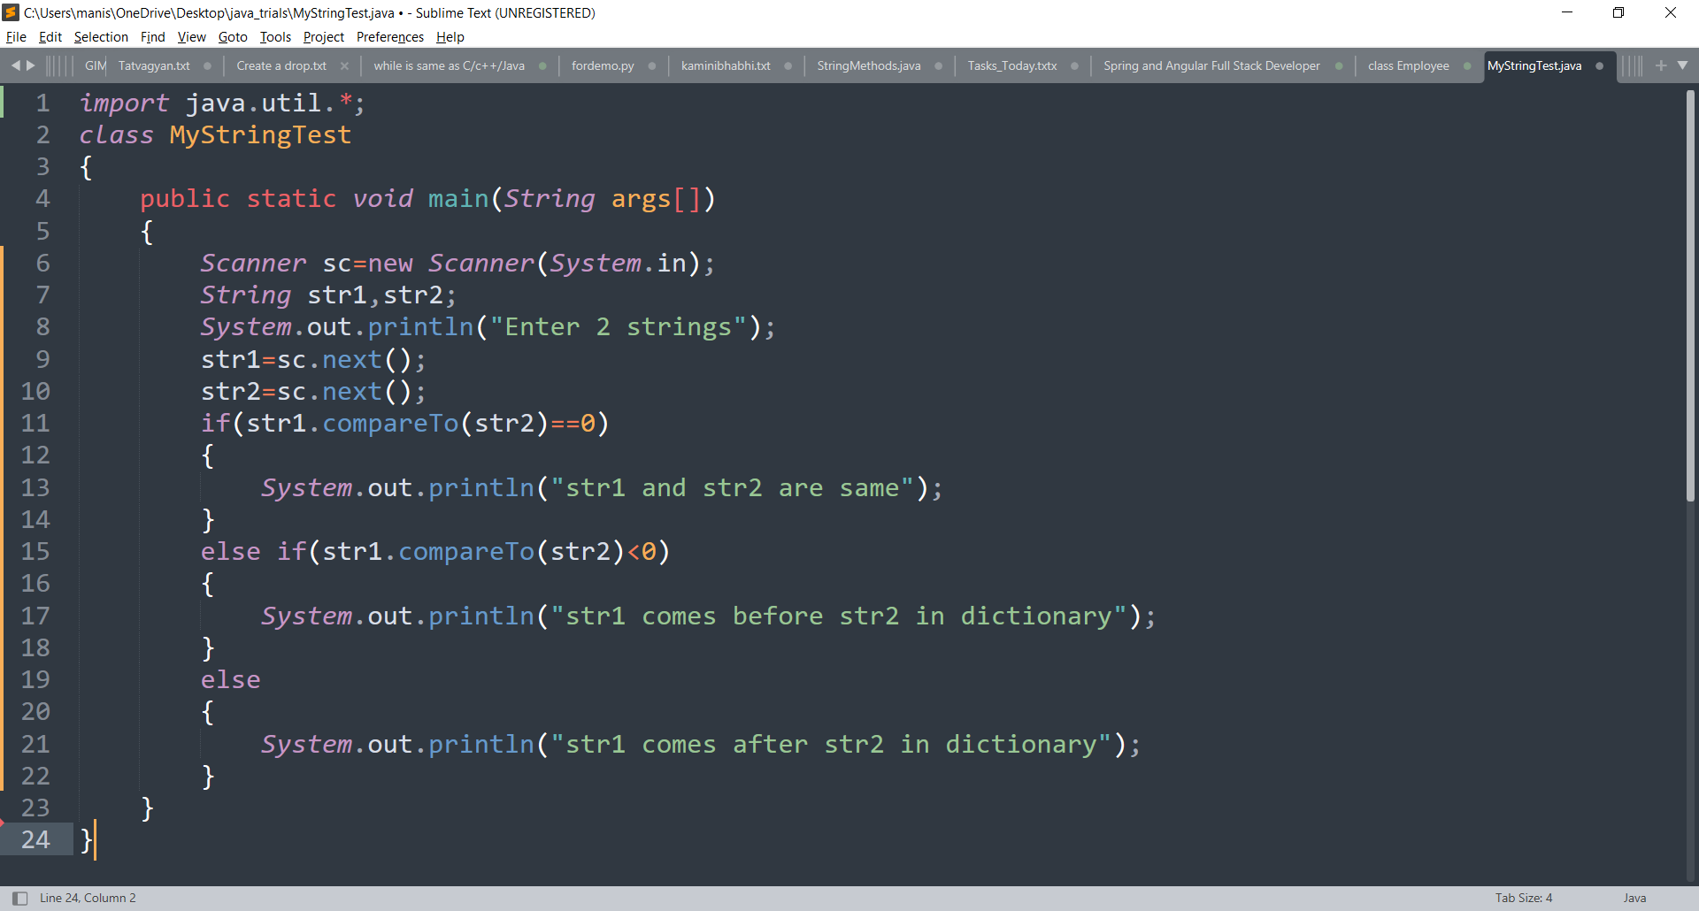

Slide 20
Enter 2 strings
hi
bye
str1 comes after str2 in dictionary
Enter 2 strings
bye
hi
str1 comes before str2 in dictionary
Enter 2 strings
bye
bye
str1 and str2 are same
Enter 2 strings
Bye
bye
str1 comes before str2 in dictionary

Slide 21
Searching Strings
The String class provides two methods that allow you to search a string for a specified character or substring:
• indexOf( ) Searches for the first occurrence of a character or substring.
int indexOf(int ch)
• lastIndexOf( ) Searches for the last occurrence of a character or substring.
int lastIndexOf(int ch)

Slide 22
Searching Strings
String str= "SBMP IT-CSE 2021";
System.out.println(str.indexOf('S')); // 0
System.out.println(str.lastIndexOf('S'));//9
To search for the first or last occurrence of a substring, use:
int indexOf(String str)
int lastIndexOf(String str)

Slide 23
Extracting a part from the String
substring( ) : It can extract a substring from the given string.
String substring(int startIndex)
This form returns a copy of the substring that begins at startIndex and runs to the
end of the invoking string.
String str= "SBMP IT-CSE 2021";
System.out.println(str.substring(3));
-CSE 2021

Slide 24
Extracting a part from the String
String substring(int startIndex, int endIndex)
The string returned contains all the characters from the beginning index, up to, but not including, the ending index.(upto endIndex-1)
String str= "SBMP IT-CSE 2021";
System.out.println(str.substring(2,9));
MP IT-C

Slide 25
trim() and replace()
The trim( ) method returns a copy of the invoking string from which any leading and trailing spaces have been removed.
String trim( )
System.out.println(" Hello World ".trim());
replace( ) : It replaces all occurrences of one character in the invoking string with another character.
String replace(char original, char replacement)
String s = "Hello".replace('l', 'w');

Slide 26
Changing the Case of Characters Within a String
String toLowerCase( )
String toUpperCase( )

Slide 27
Thanks!
Any questions?
You can find me at:
manish_ratilal2002@yahoo.com

Slide 28
Credits
Java The Complete Reference book

